Slide 1





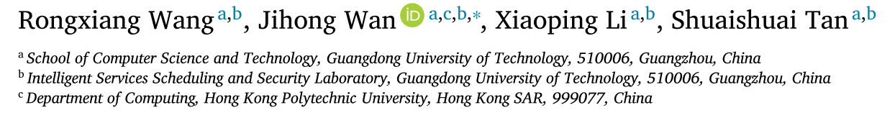





ATAI
Advanced Techniqueof Artificial Intelligence
ATAI
ChongqingUniversity _{AdvancedTechniqueof}
of Technology Artificial Intelligence
Chongqing University of
Technology
Chongqing University ^{ATAI}
_{of Technology} Advanced Techniqueof
Artificial Intelligence
Chongqing University of Technology
Chongqing University of Technology
Fast and robust outlier detection: A granular-ball center isolation and
region consistency approach
Code: None
—— PR_2026
Reported by HongLiang Nie
1

Slide 2

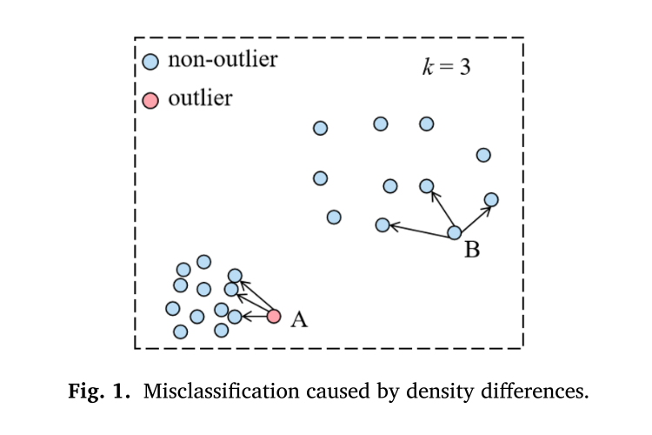
ATAI
AdvancedTechniqueof
Artificial Intelligence
ATAI
ChongqingUniversity _{AdvancedTechniqueof}
of Technology Artificial Intelligence
ChongqingUniversity of Technology
Motivation
(1) These methods typically require searching for the 𝑘-NNs of each object. As the size of the dataset increases, this process becomes very time-consuming. This leads to the inefficiency of nearest neighbor-based outlier detection methods.
(3) Although distance-based methods are simple and intuitive, they are influenced by local density issues. As shown in Fig. 1, the distance between the normal point B in the low-density region and its neighboring points is greater than the distance between the outlier point A in the high-density region and its neighboring points.This can lead to the misclassification of point A as a normal point
(2) When the 𝑘-NNs of a object contain noise, these noise can interfere with distance or density calculations

Slide 3

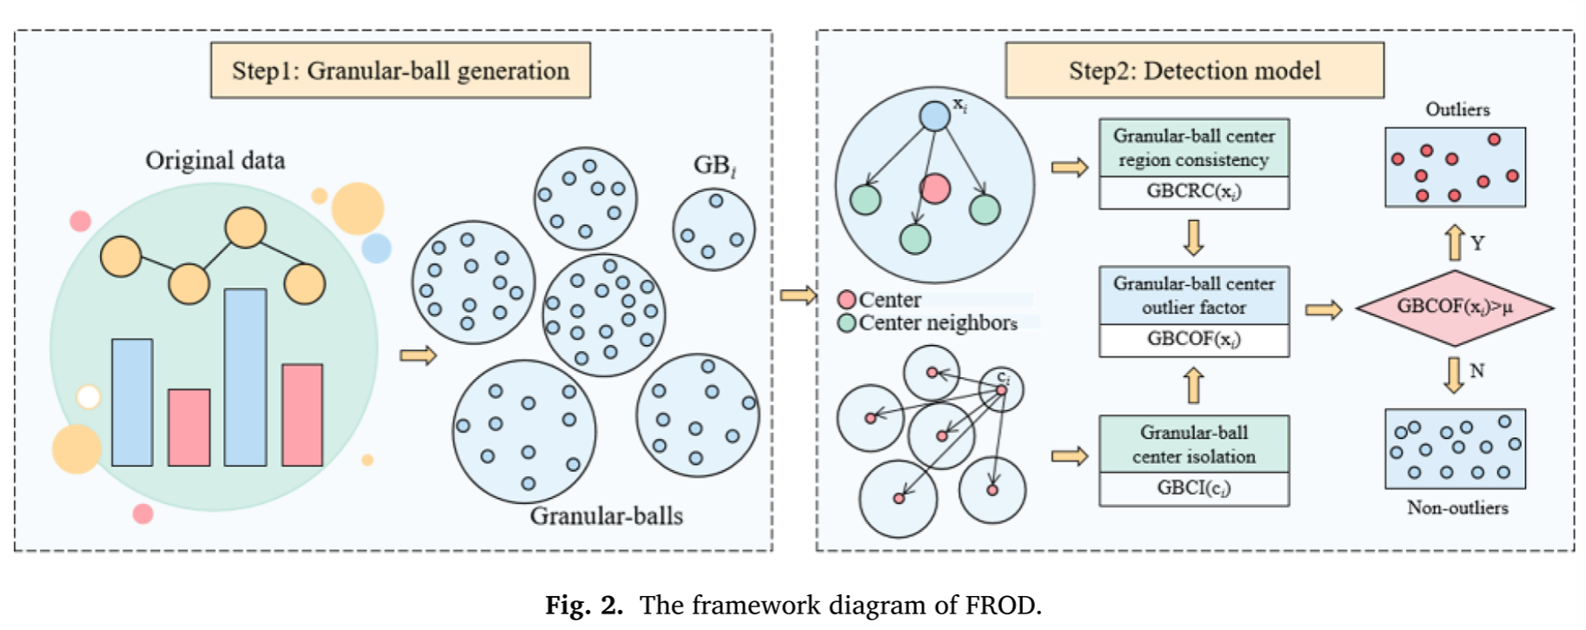
ChongqingUniversity of Technology
ATAI
AdvancedTechniqueof
Artificial Intelligence
ATAI
ChongqingUniversity _{AdvancedTechniqueof}
of Technology Artificial Intelligence
Overview

Slide 4
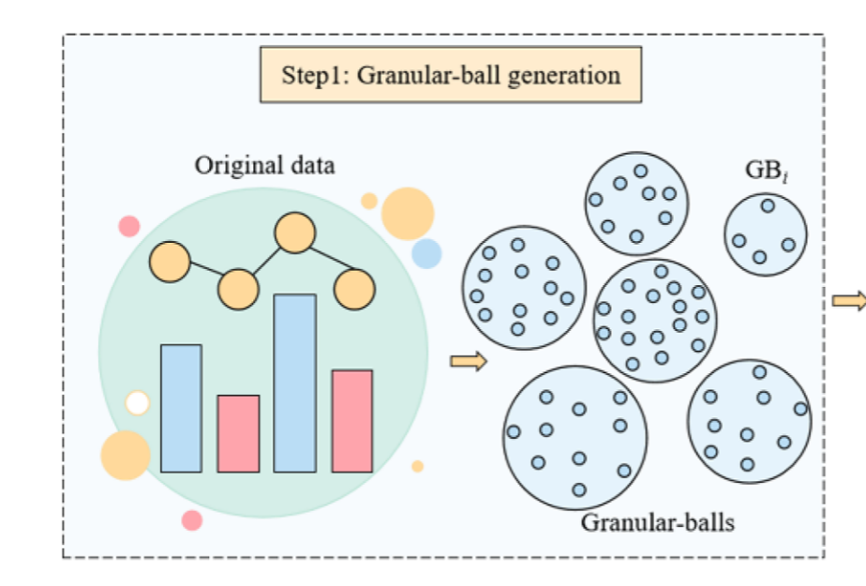
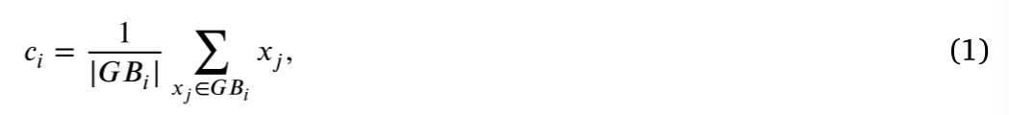
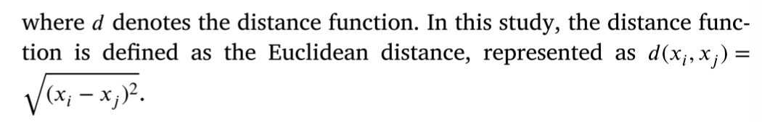
ChongqingUniversity of Technology
ATAI
AdvancedTechniqueof
Artificial Intelligence
ATAI
ChongqingUniversity _{AdvancedTechniqueof}
of Technology Artificial Intelligence
Overview

Slide 5
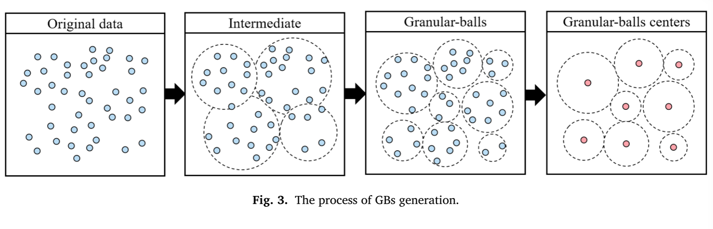
ChongqingUniversity of Technology
ATAI
AdvancedTechniqueof
Artificial Intelligence
ATAI
ChongqingUniversity _{AdvancedTechniqueof}
of Technology Artificial Intelligence
Method

Slide 6
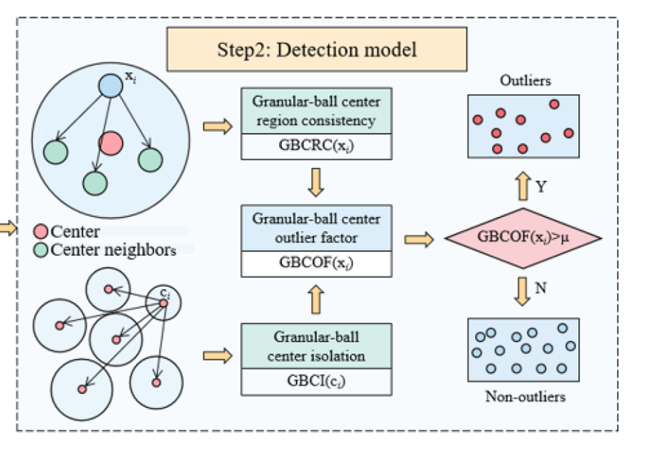
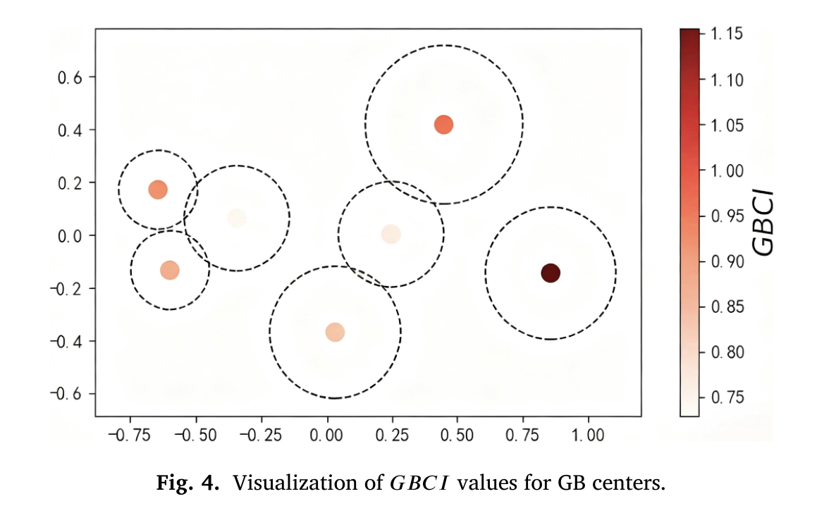
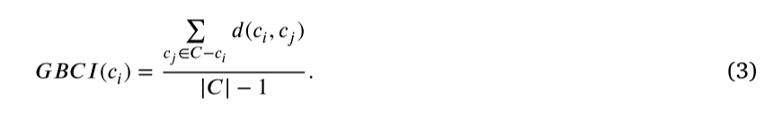
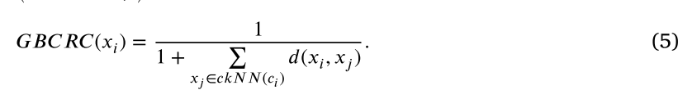

ChongqingUniversity of Technology
ATAI
AdvancedTechniqueof
Artificial Intelligence
ATAI
ChongqingUniversity _{AdvancedTechniqueof}
of Technology Artificial Intelligence
Overview

Slide 7

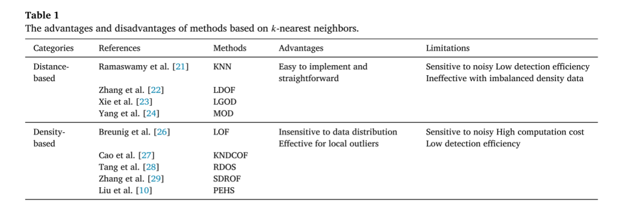
ATAI
AdvancedTechniqueof
Artificial Intelligence
ATAI
ChongqingUniversity _{AdvancedTechniqueof}
of Technology Artificial Intelligence
ChongqingUniversity of Technology
Experiments

Slide 8
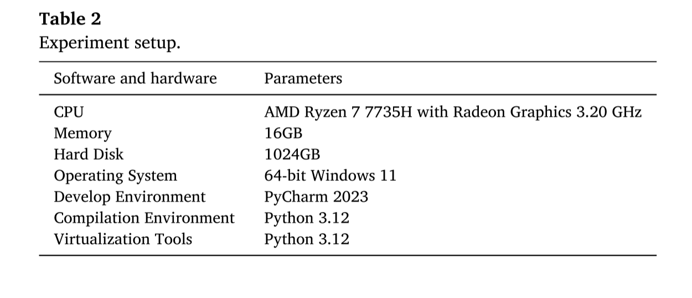
ATAI
AdvancedTechniqueof
Artificial Intelligence
ATAI
ChongqingUniversity _{AdvancedTechniqueof}
of Technology Artificial Intelligence
ChongqingUniversity of Technology
Experiments

Slide 9
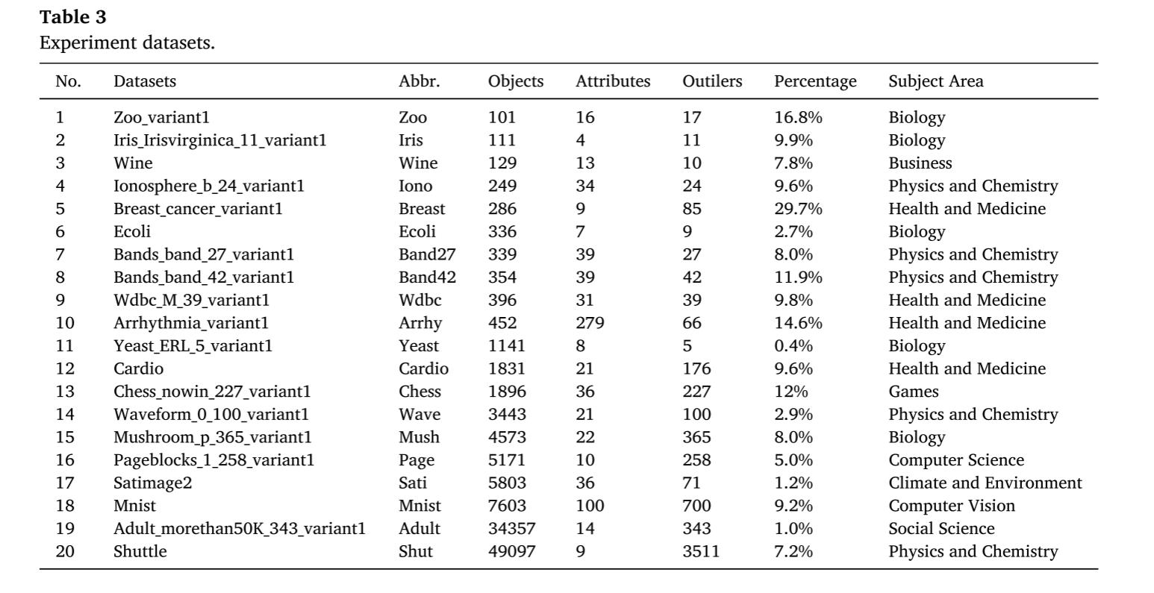
ATAI
AdvancedTechniqueof
Artificial Intelligence
ATAI
ChongqingUniversity _{AdvancedTechniqueof}
of Technology Artificial Intelligence
ChongqingUniversity of Technology
Experiments

Slide 10
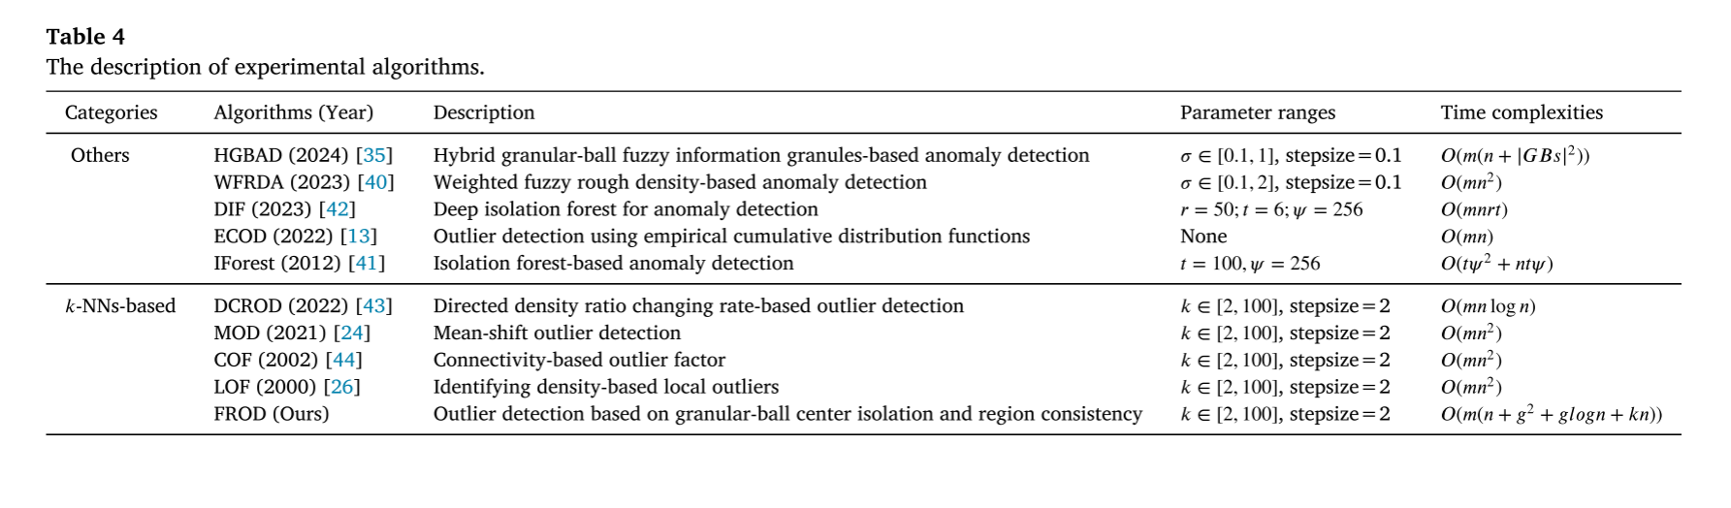
ATAI
AdvancedTechniqueof
Artificial Intelligence
ATAI
ChongqingUniversity _{AdvancedTechniqueof}
of Technology Artificial Intelligence
ChongqingUniversity of Technology
Experiments

Slide 11
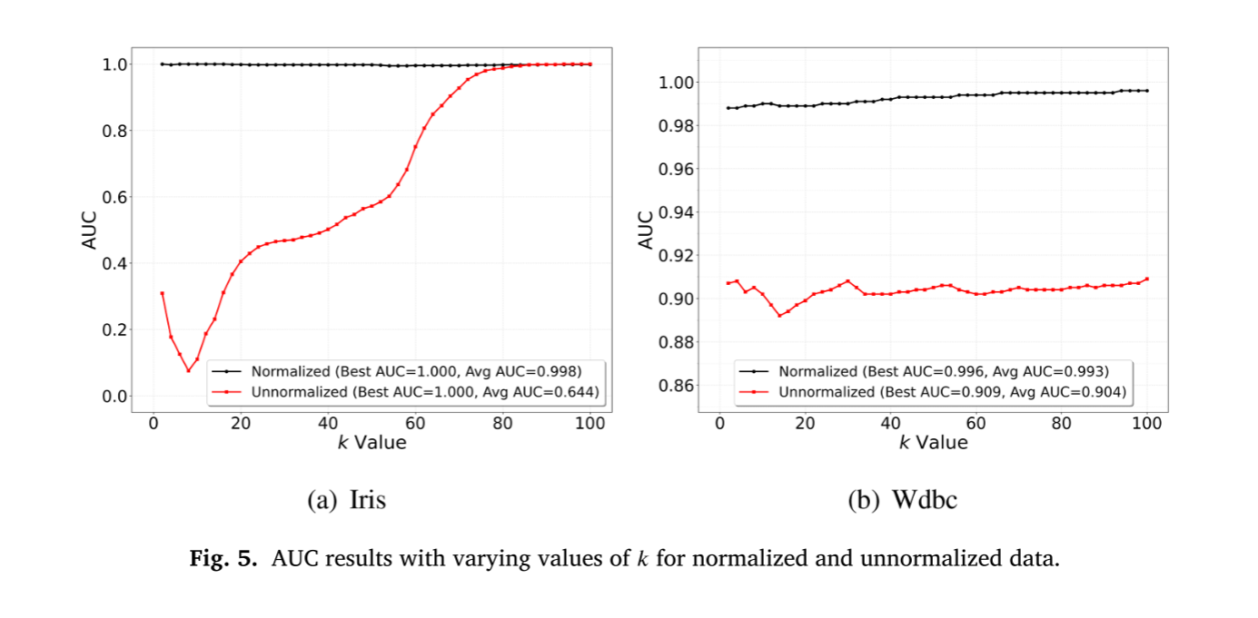
ATAI
AdvancedTechniqueof
Artificial Intelligence
ATAI
ChongqingUniversity _{AdvancedTechniqueof}
of Technology Artificial Intelligence
ChongqingUniversity of Technology
Experiments

Slide 12
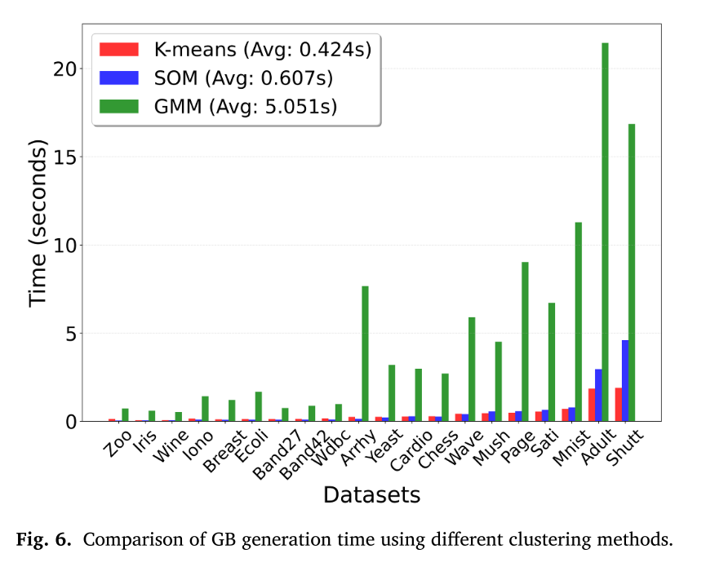
ATAI
AdvancedTechniqueof
Artificial Intelligence
ATAI
ChongqingUniversity _{AdvancedTechniqueof}
of Technology Artificial Intelligence
ChongqingUniversity of Technology
Experiments

Slide 13
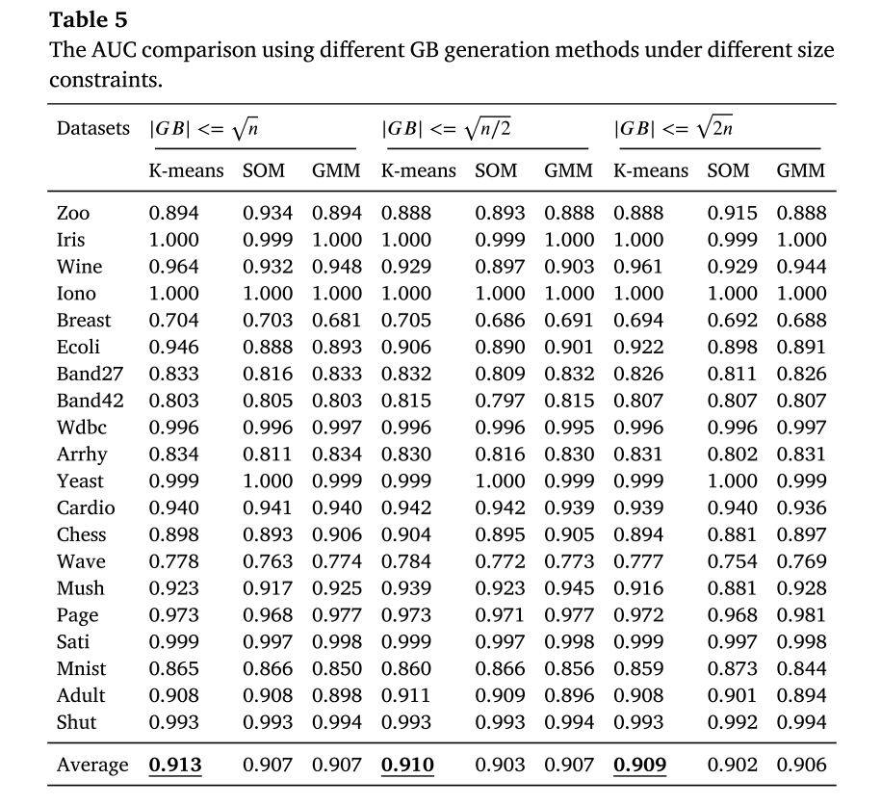
ATAI
AdvancedTechniqueof
Artificial Intelligence
ATAI
ChongqingUniversity _{AdvancedTechniqueof}
of Technology Artificial Intelligence
ChongqingUniversity of Technology
Experiments

Slide 14
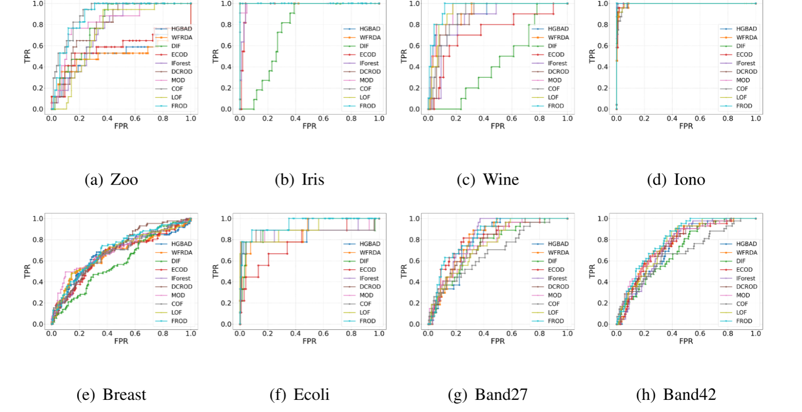
ATAI
AdvancedTechniqueof
Artificial Intelligence
ATAI
ChongqingUniversity _{AdvancedTechniqueof}
of Technology Artificial Intelligence
ChongqingUniversity of Technology
Experiments

Slide 15
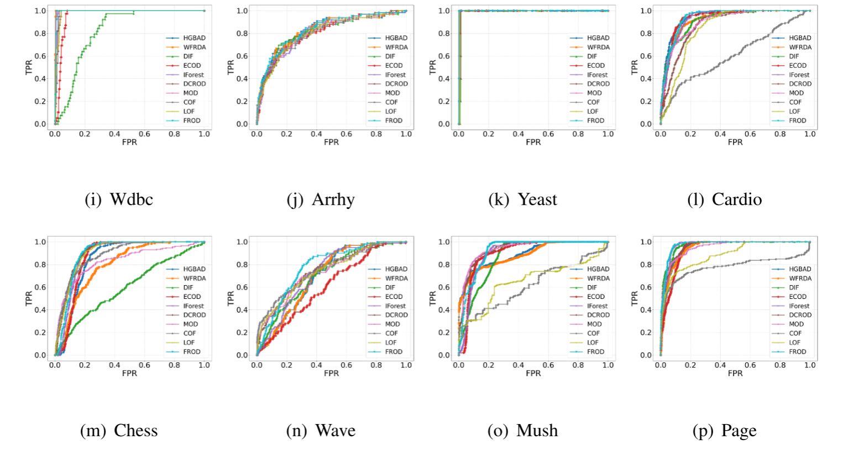
ATAI
AdvancedTechniqueof
Artificial Intelligence
ATAI
ChongqingUniversity _{AdvancedTechniqueof}
of Technology Artificial Intelligence
ChongqingUniversity of Technology
Experiments

Slide 16
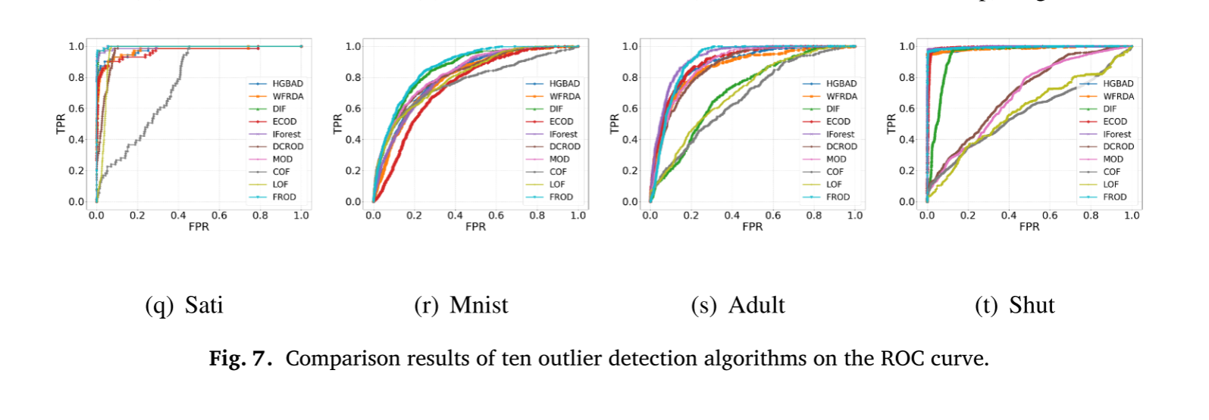
ATAI
AdvancedTechniqueof
Artificial Intelligence
ATAI
ChongqingUniversity _{AdvancedTechniqueof}
of Technology Artificial Intelligence
ChongqingUniversity of Technology
Experiments

Slide 17
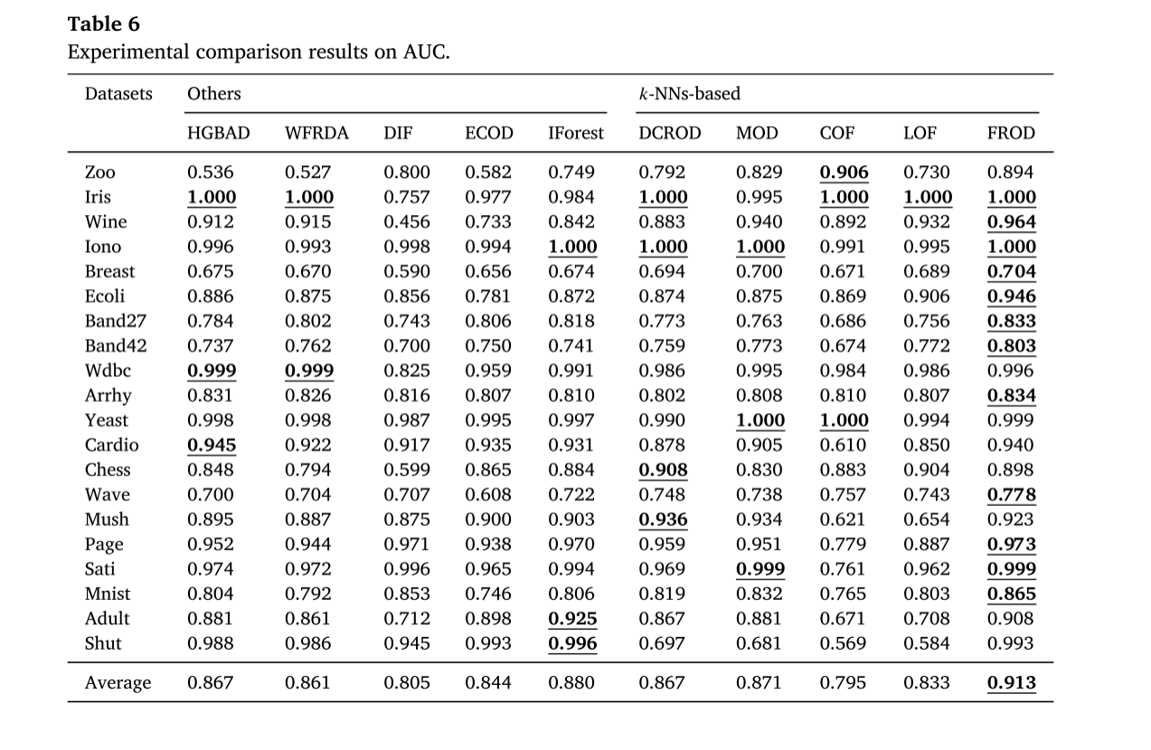
ATAI
AdvancedTechniqueof
Artificial Intelligence
ATAI
ChongqingUniversity _{AdvancedTechniqueof}
of Technology Artificial Intelligence
ChongqingUniversity of Technology
Experiments

Slide 18
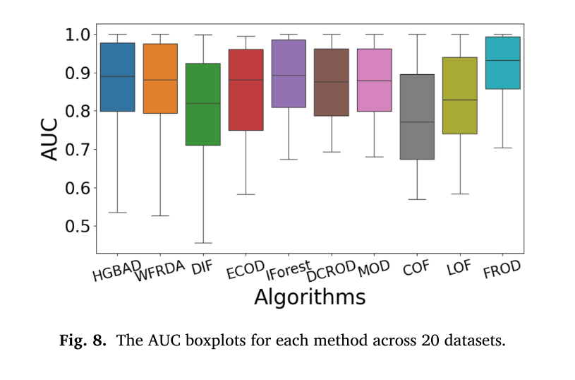
ATAI
AdvancedTechniqueof
Artificial Intelligence
ATAI
ChongqingUniversity _{AdvancedTechniqueof}
of Technology Artificial Intelligence
ChongqingUniversity of Technology
Experiments

Slide 19
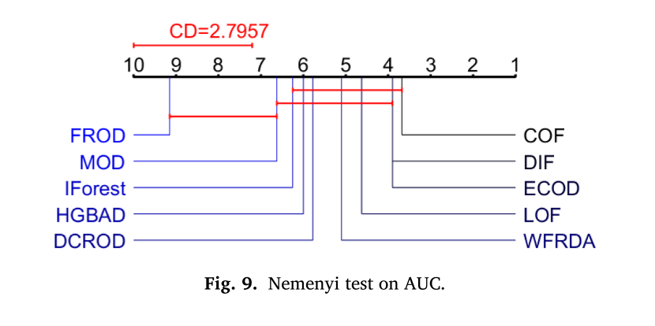
ATAI
AdvancedTechniqueof
Artificial Intelligence
ATAI
ChongqingUniversity _{AdvancedTechniqueof}
of Technology Artificial Intelligence
ChongqingUniversity of Technology
Experiments

Slide 20
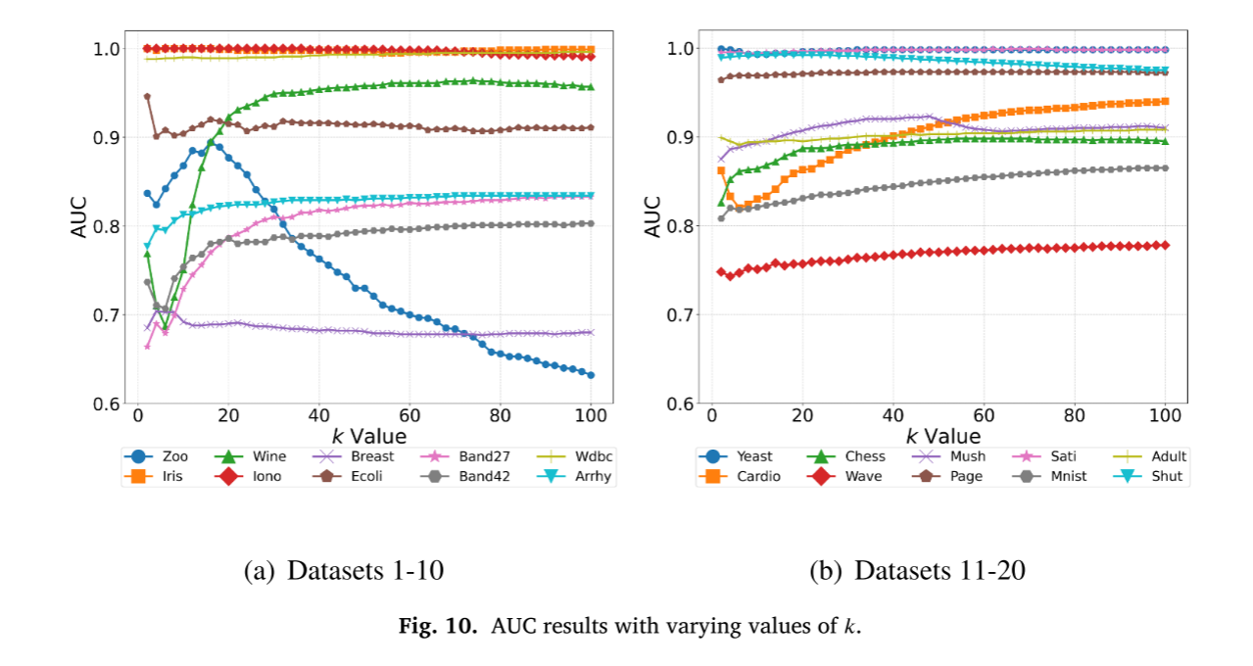
ATAI
AdvancedTechniqueof
Artificial Intelligence
ATAI
ChongqingUniversity _{AdvancedTechniqueof}
of Technology Artificial Intelligence
ChongqingUniversity of Technology
Experiments

Slide 21
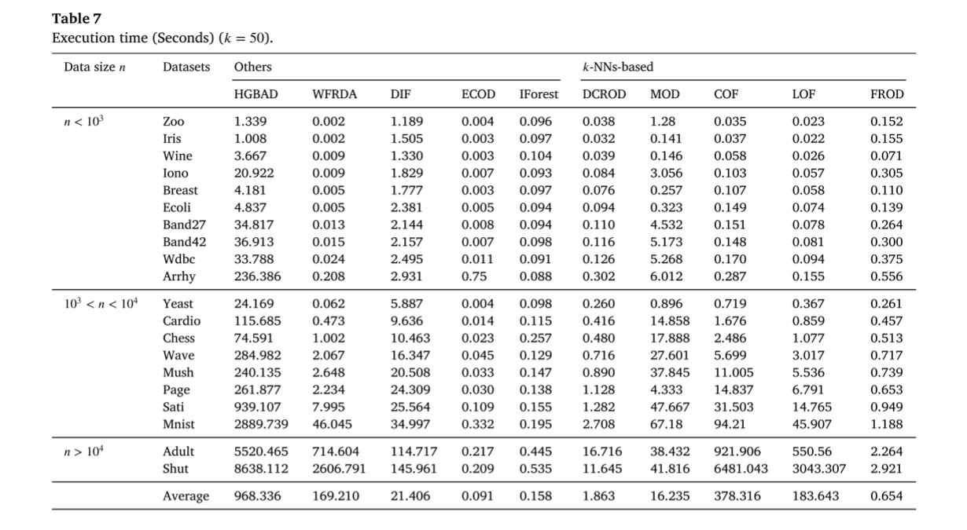
ATAI
AdvancedTechniqueof
Artificial Intelligence
ATAI
ChongqingUniversity _{AdvancedTechniqueof}
of Technology Artificial Intelligence
ChongqingUniversity of Technology
Experiments

Slide 22
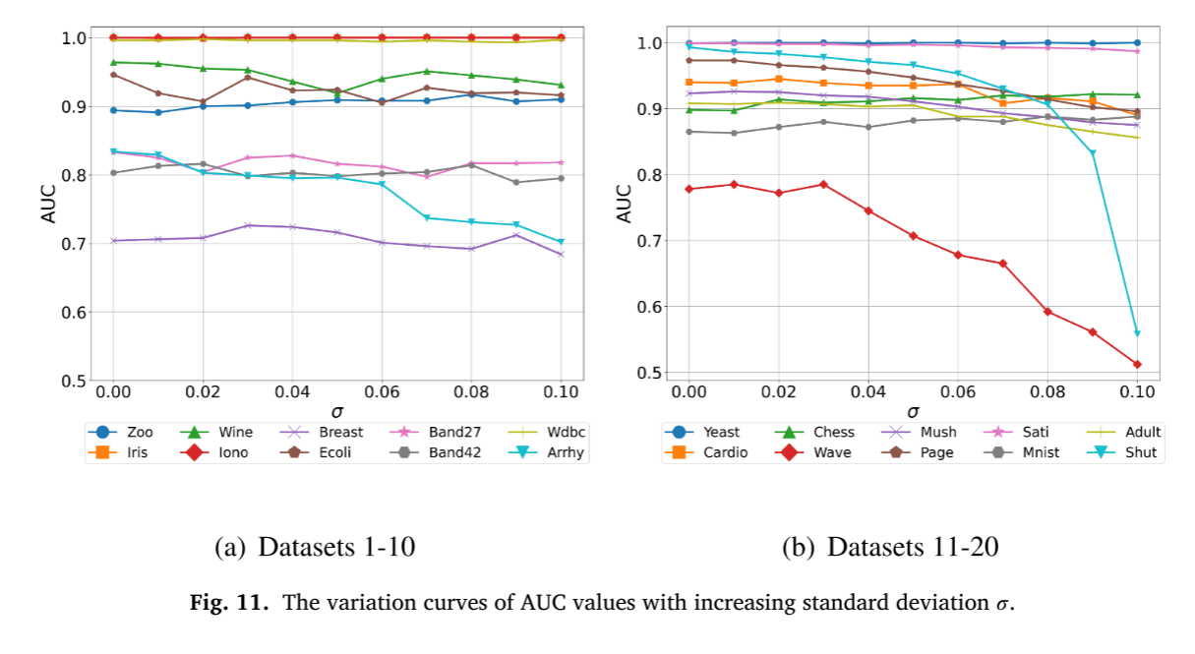
ATAI
AdvancedTechniqueof
Artificial Intelligence
ATAI
ChongqingUniversity _{AdvancedTechniqueof}
of Technology Artificial Intelligence
ChongqingUniversity of Technology
Experiments

Slide 23


ChongqingUniversity of Technology
ATAI
AdvancedTechniqueof
Artificial Intelligence
ATAI
ChongqingUniversity _{AdvancedTechniqueof}
of Technology Artificial Intelligence
Thanks!

